Slide 1
Experiment Tracking
with WandB

Slide 2
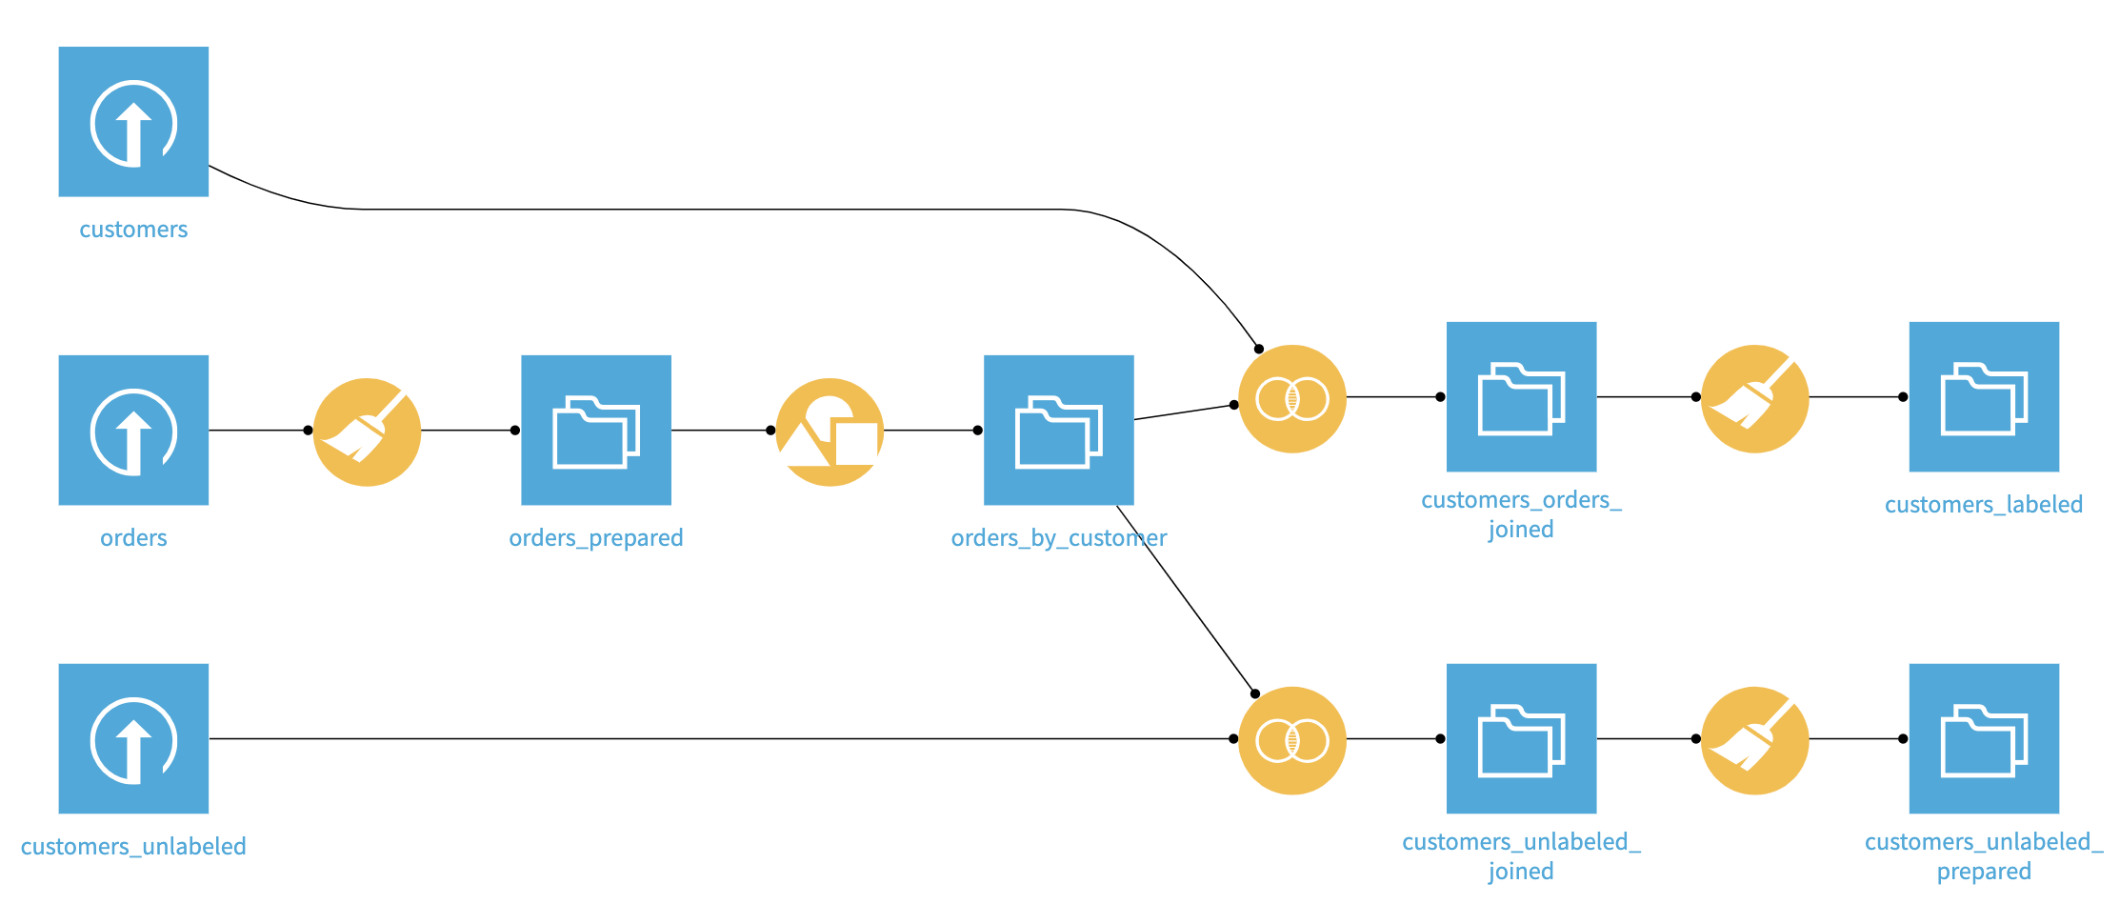
HighRev
Predict HighRevenue Customers - Dataiku

Slide 3
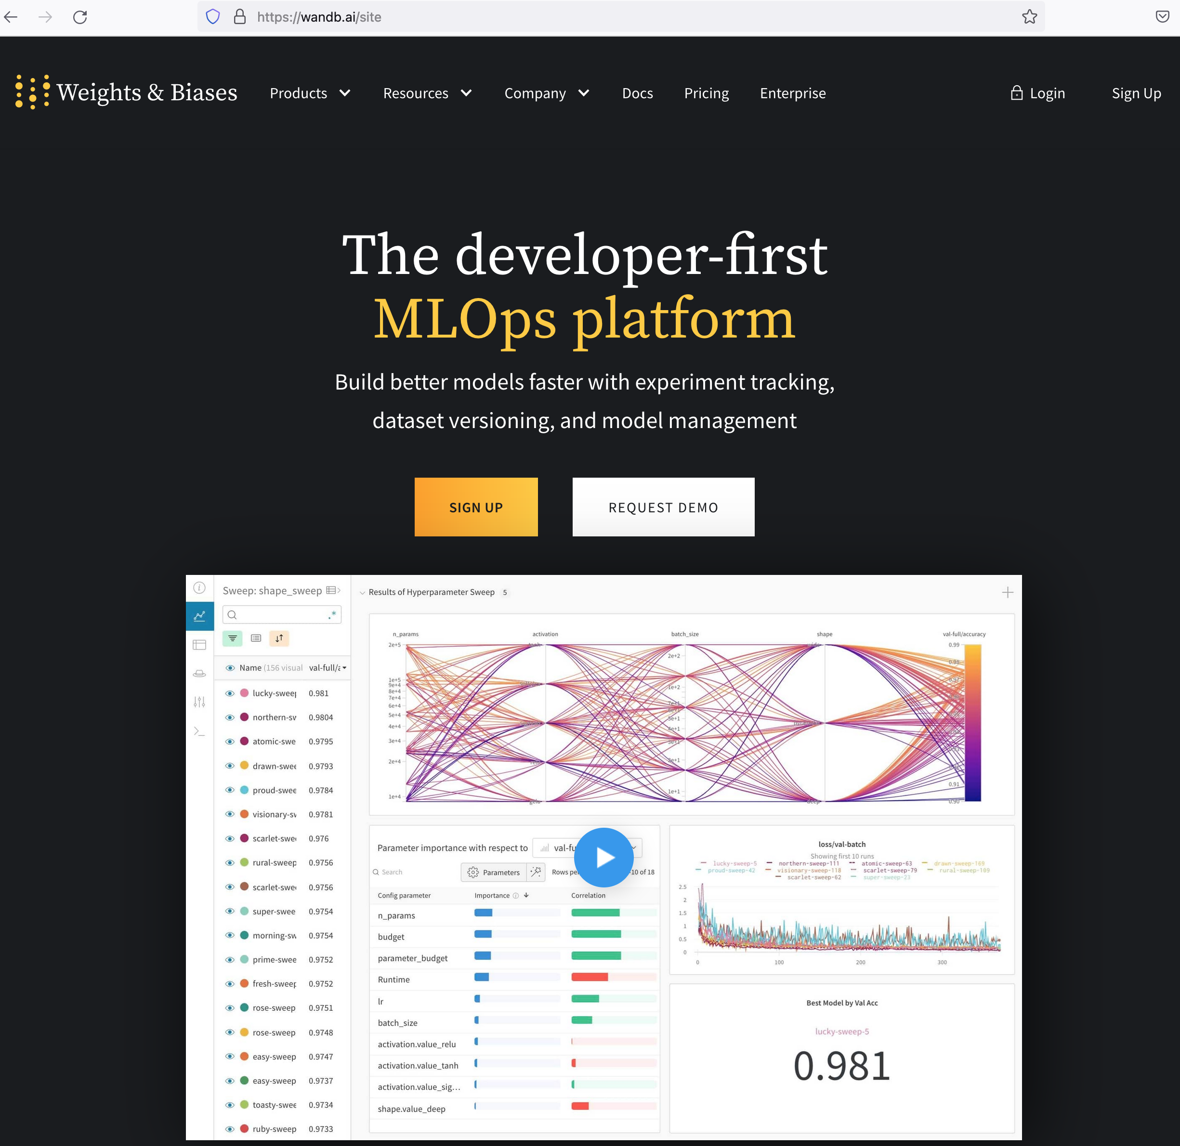

Slide 4
4. Tune hiperparameters
3. Log and use artifacts
2. Log plots and tables
1. Basic Logging

Slide 5
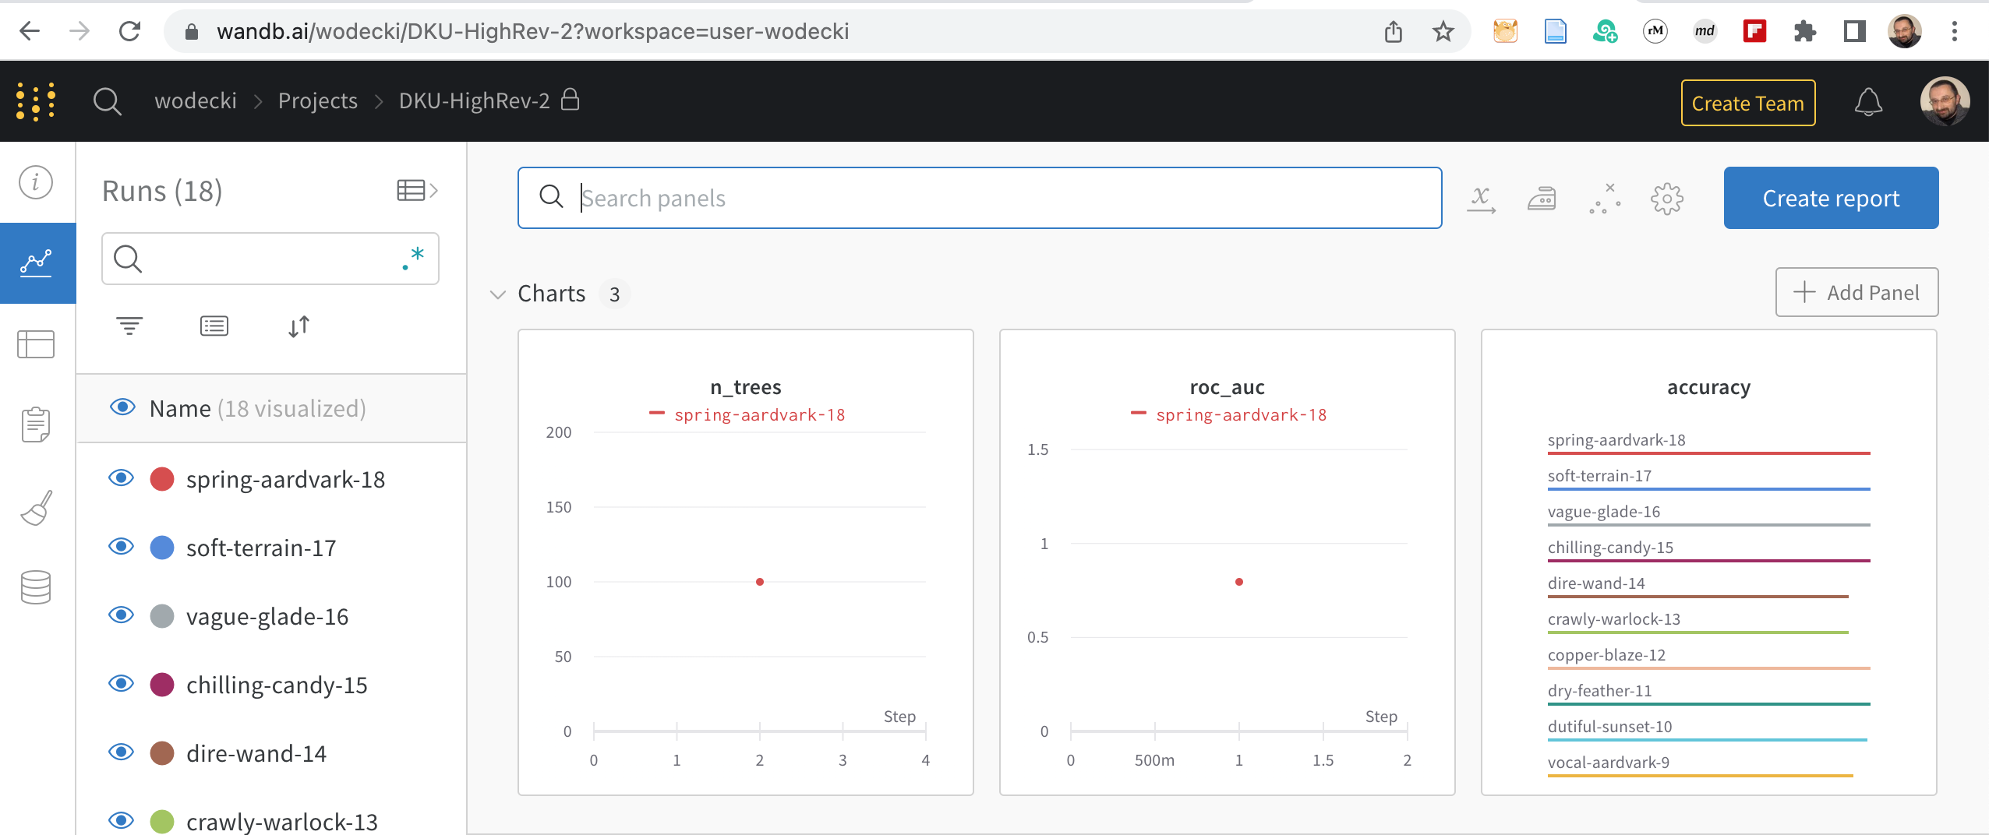
Log basic parameters and measures
… across multiple runs

Slide 6
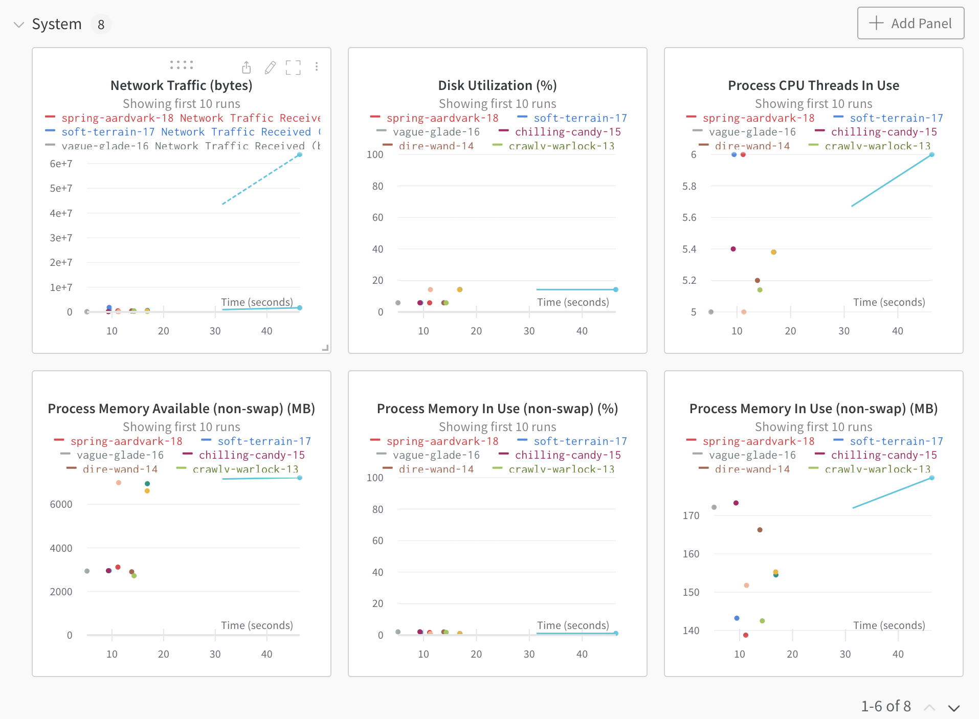
Automatically track system logs

Slide 7
Automatically track system logs

Slide 8
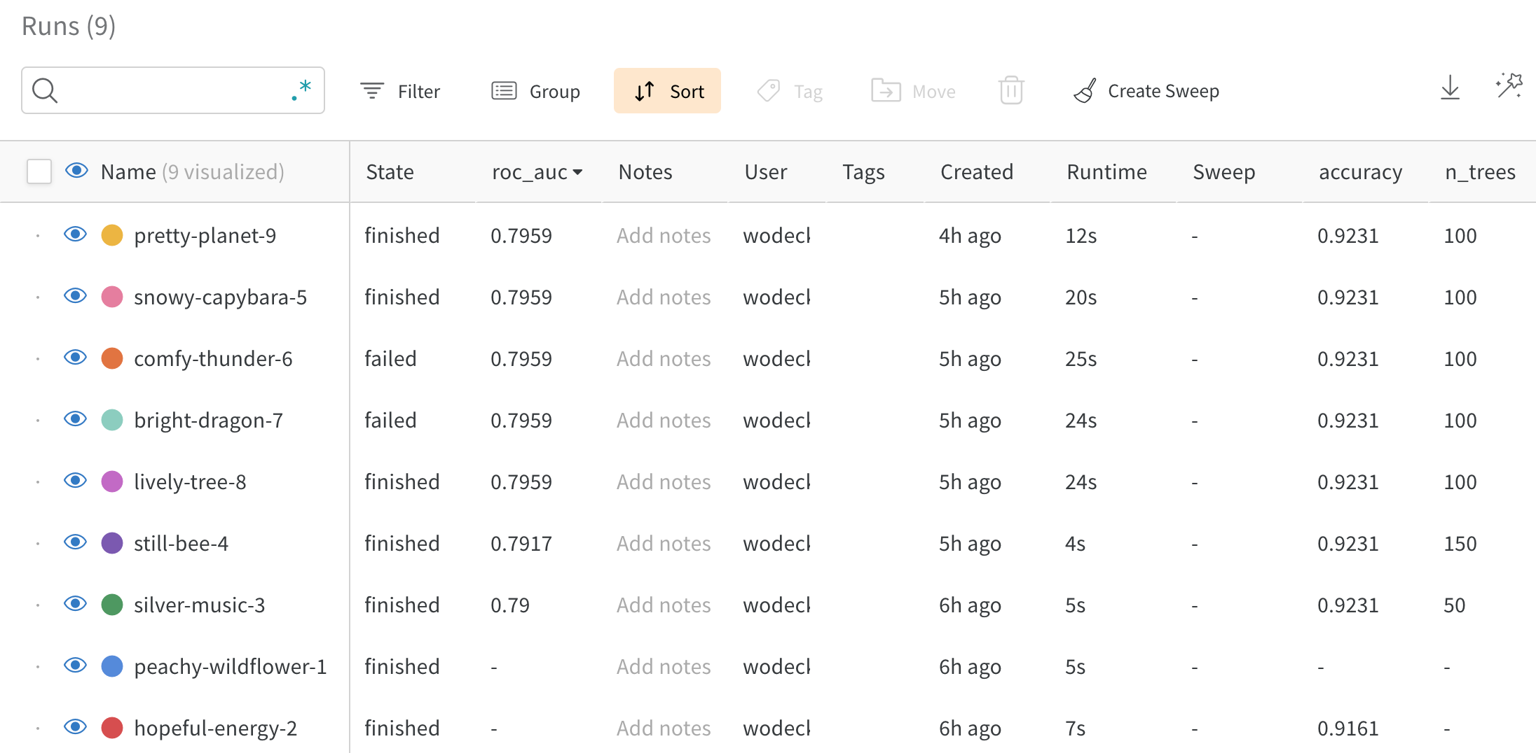
Compare runs results

Slide 9
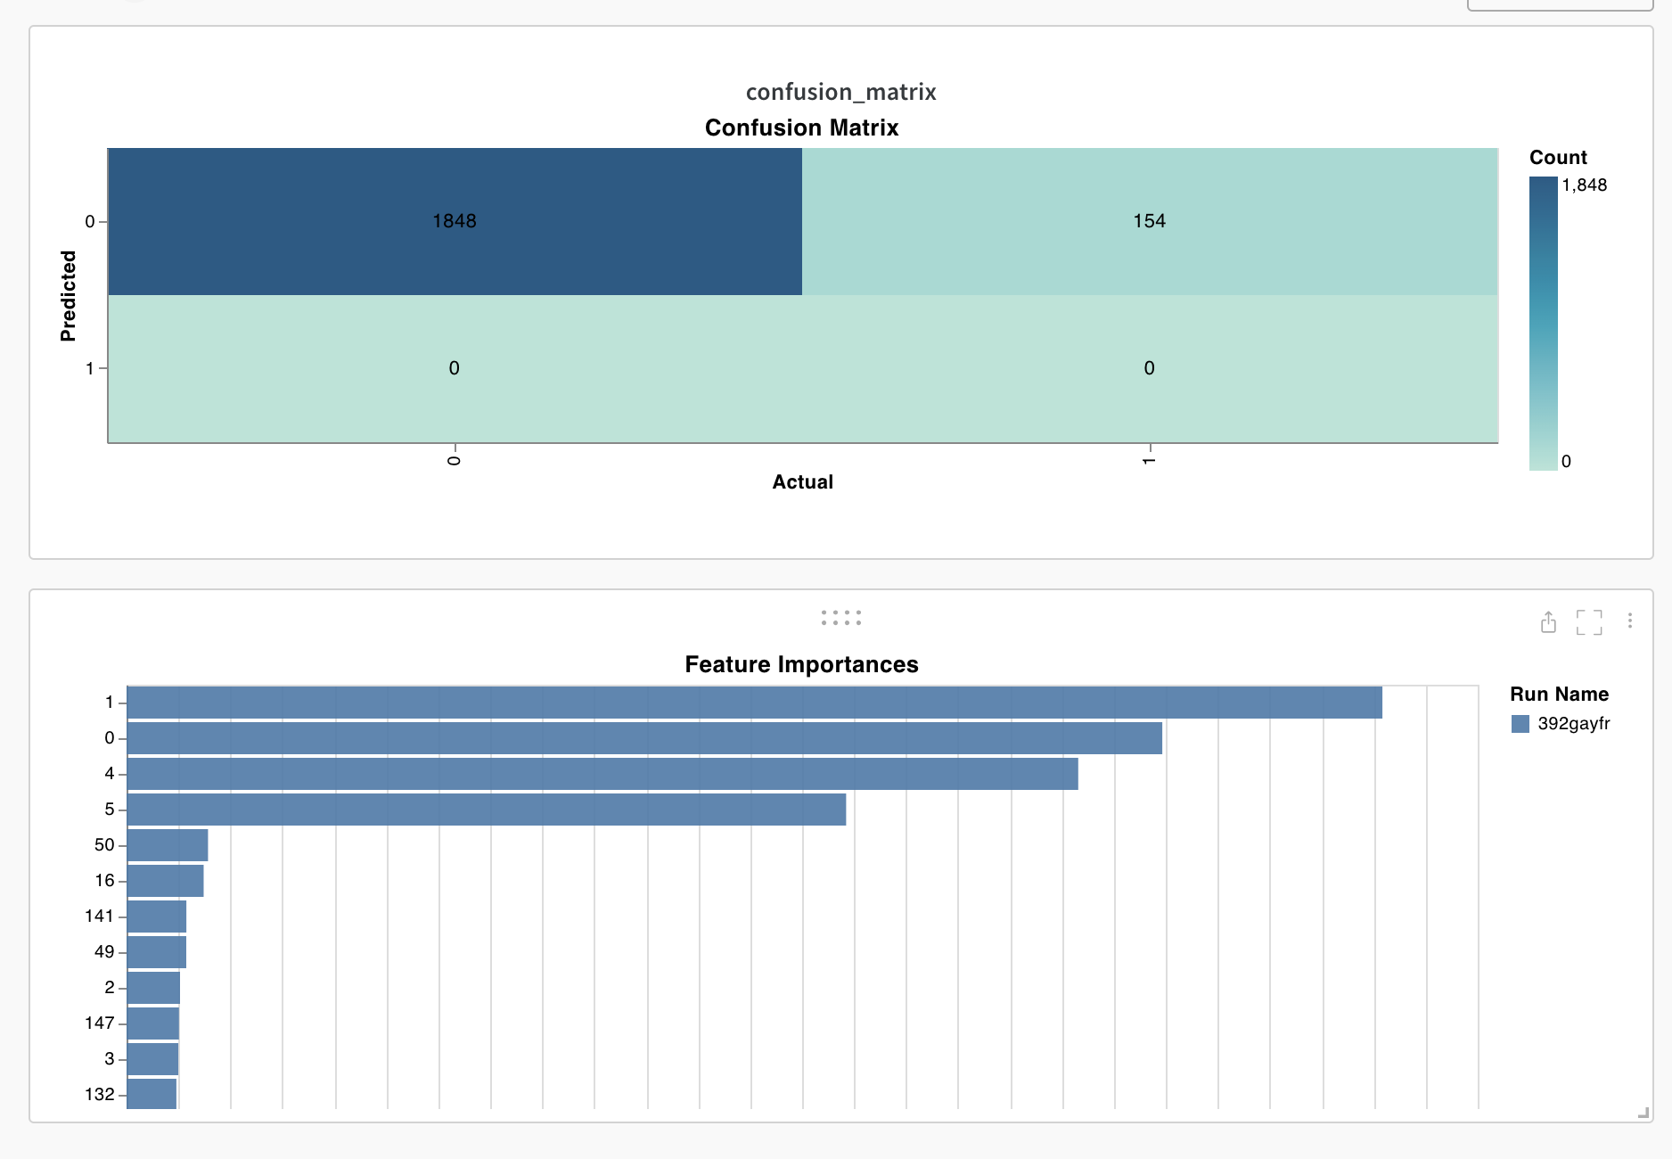
Log plots…

Slide 10
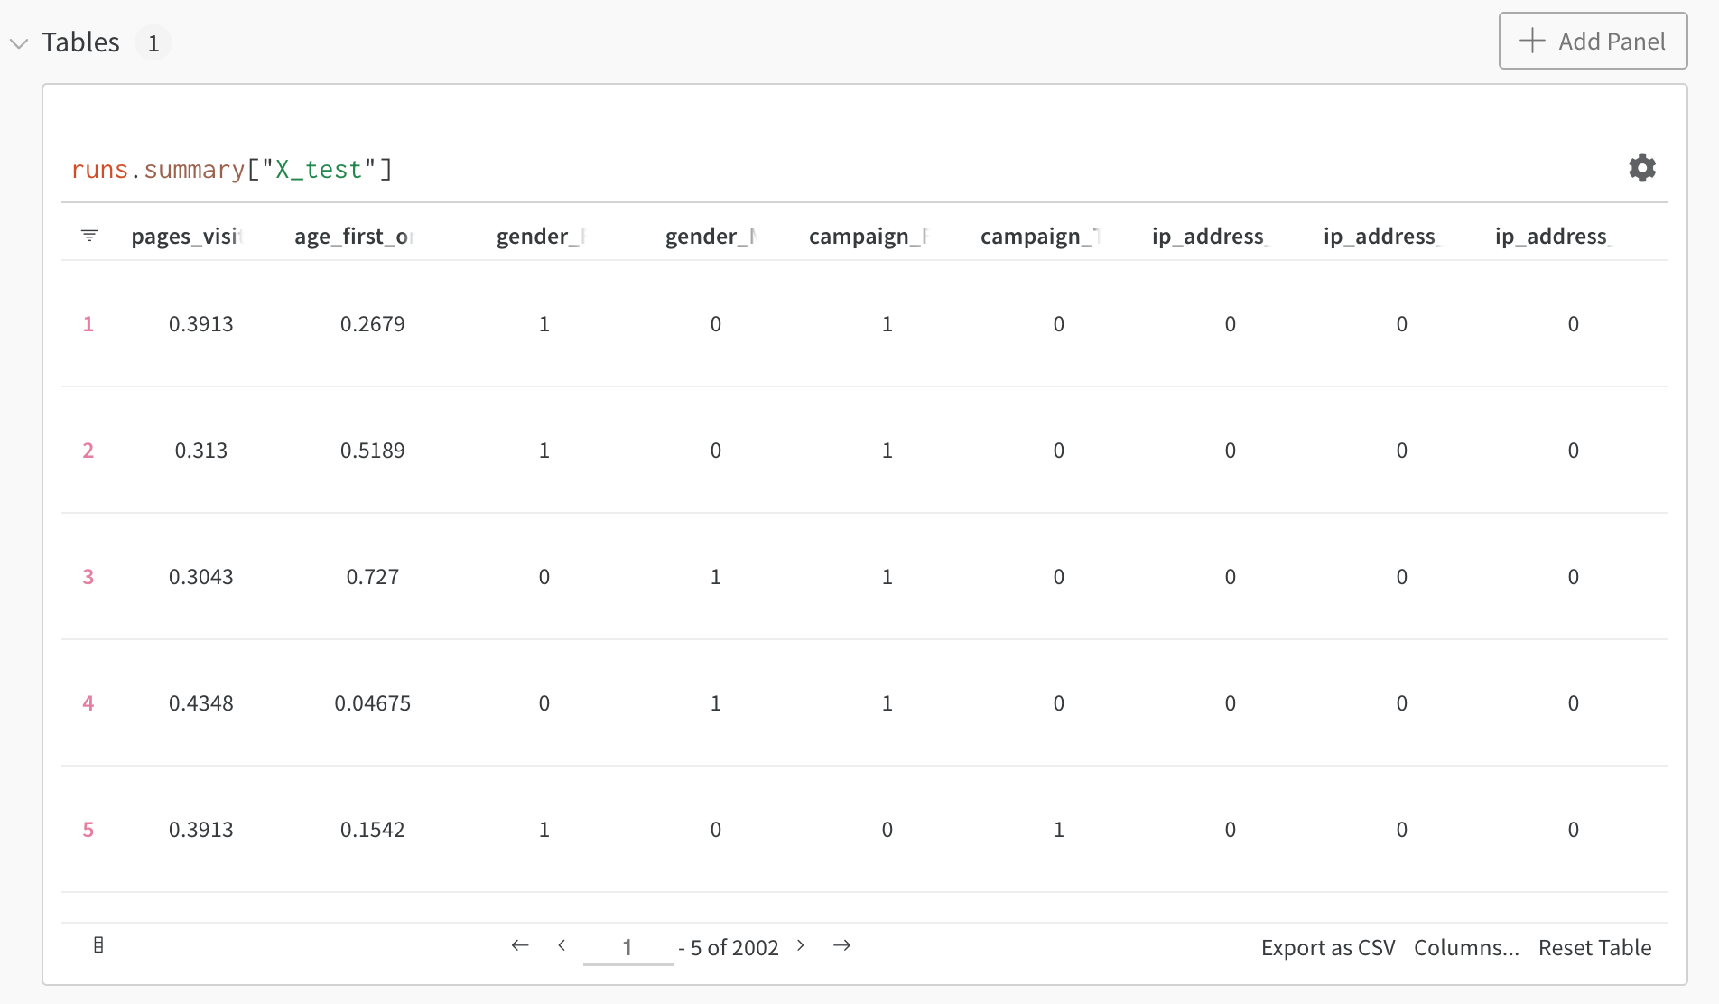
… tables …

Slide 11
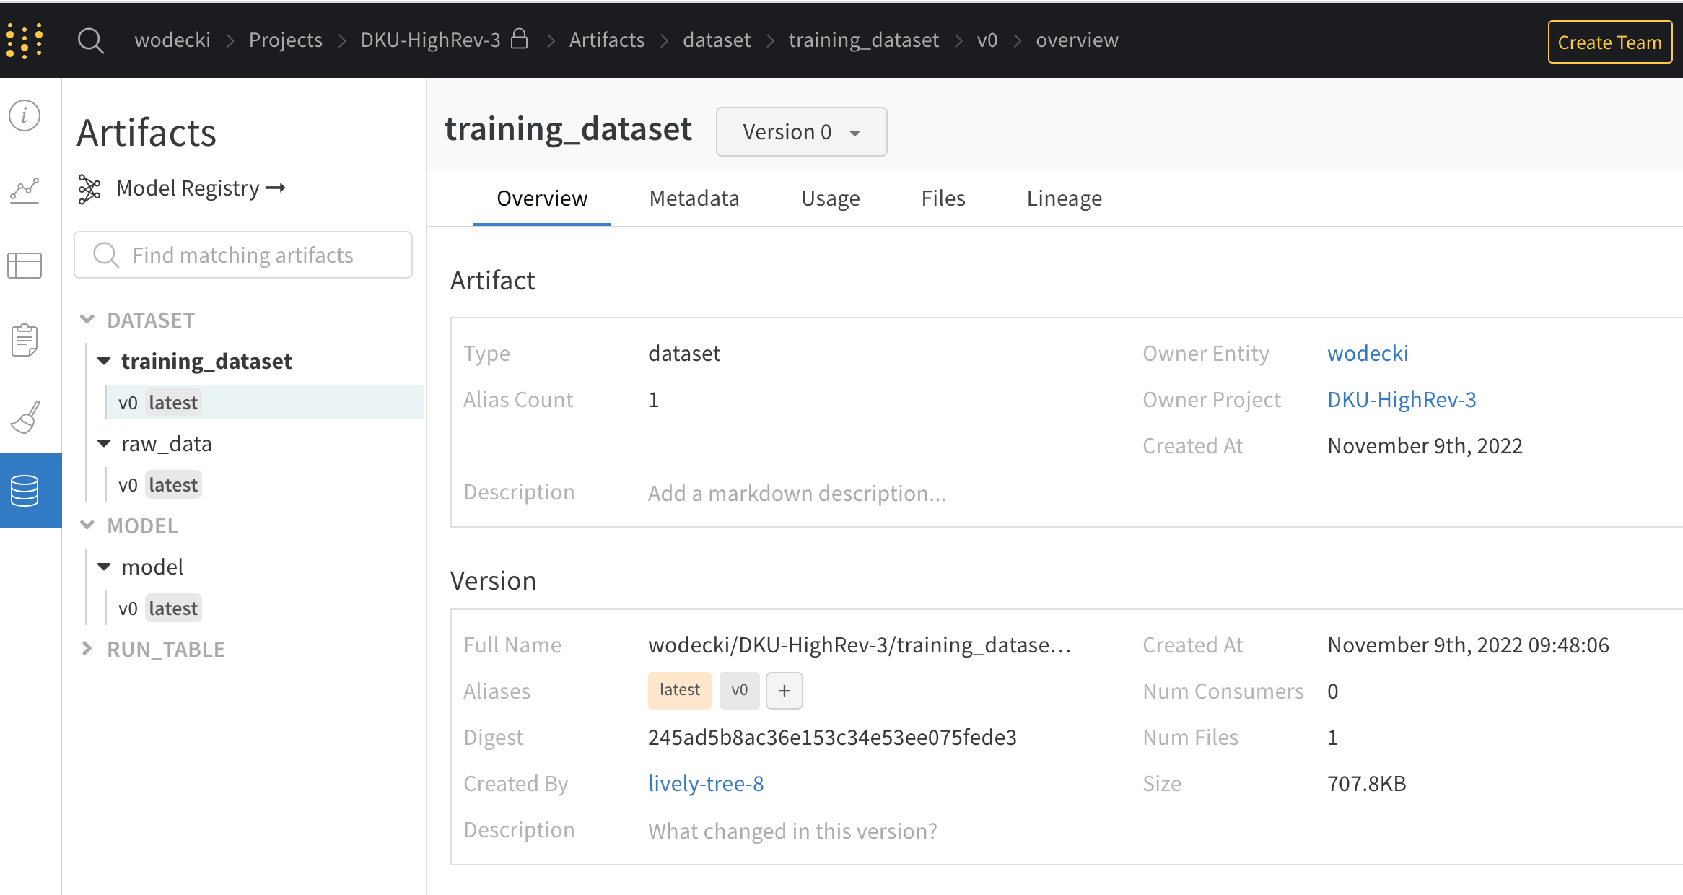
… and artifacts

Slide 12
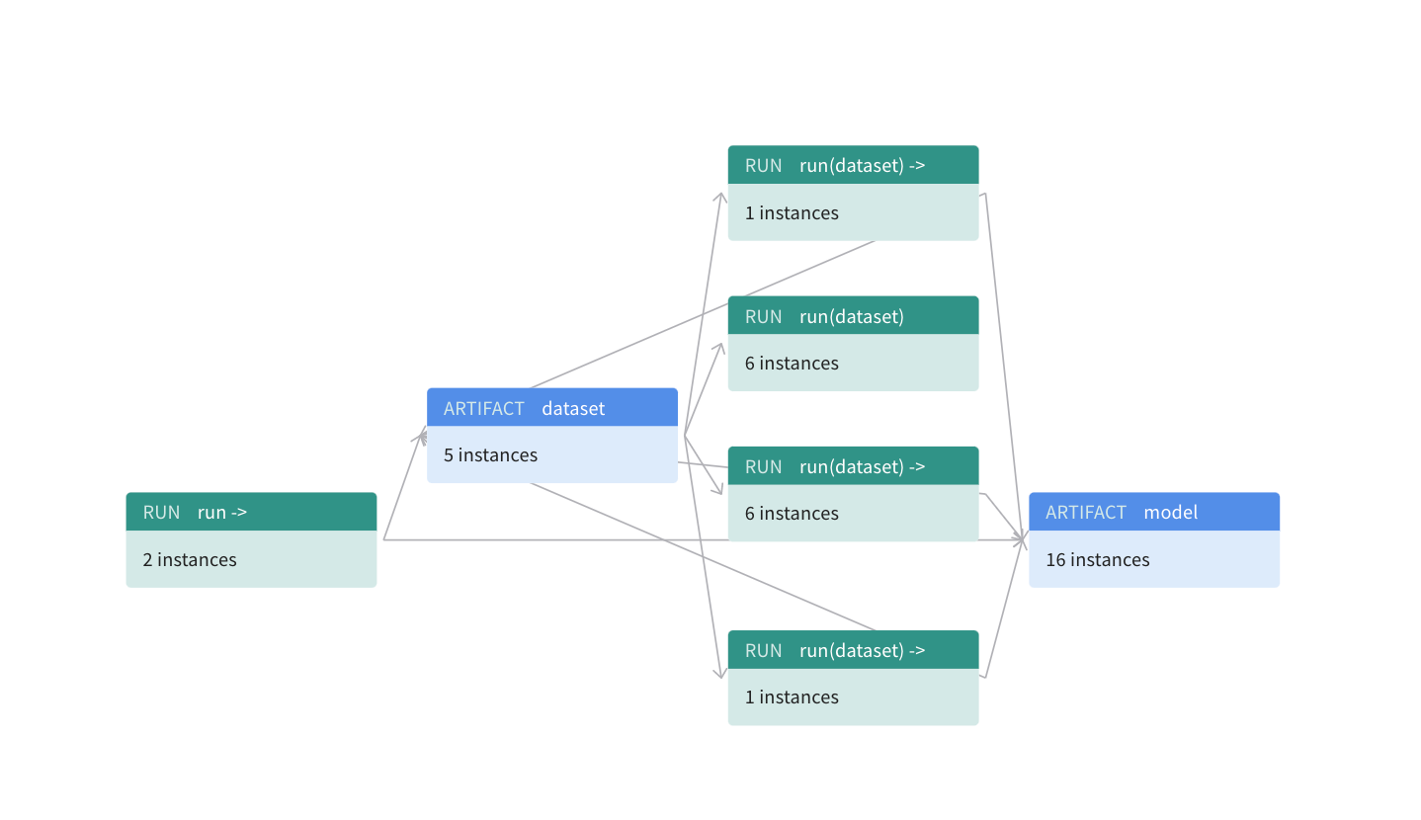
Track artifacts lineage…

Slide 13
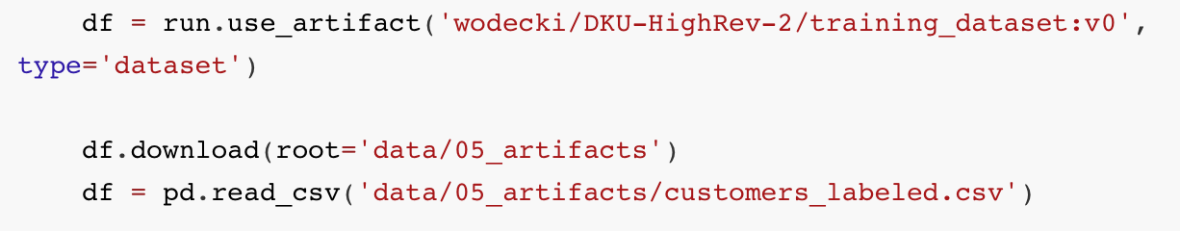
… and re-use them if needed

Slide 14
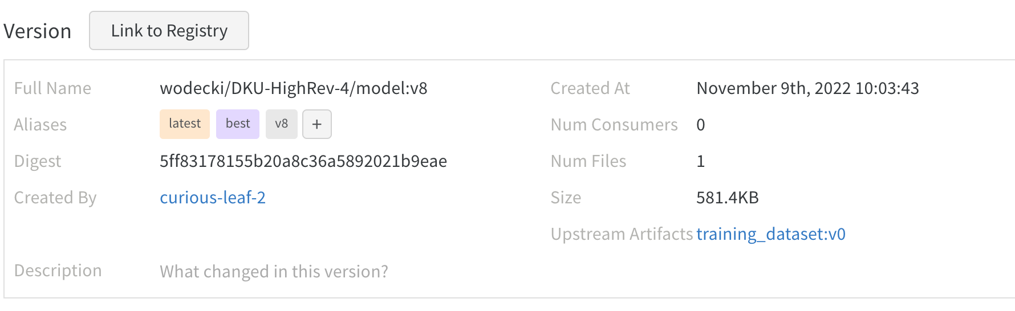
Automatically tag the best model as „best”

Slide 15
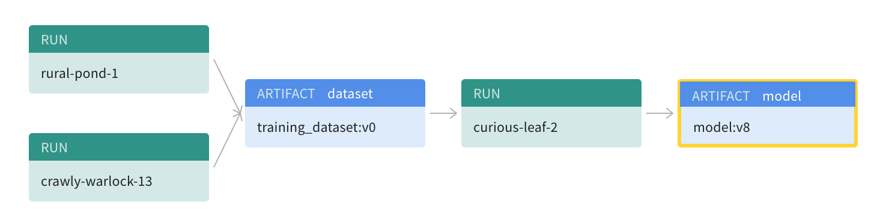
Track its lineage

Slide 16
import wandb
run = wandb.init()
artifact = run.use_artifact('wodecki/DKU-HighRev-4/model:best', type='model’)
artifact_dir = artifact.download()
… and reuse in Your CI/CD pipeline

Slide 17
import wandb
run = wandb.init()
artifact = run.use_artifact('wodecki/DKU-HighRev-4/model:best', type='model’)
artifact_dir = artifact.download()
… and reuse in Your CI/CD pipeline

Slide 18
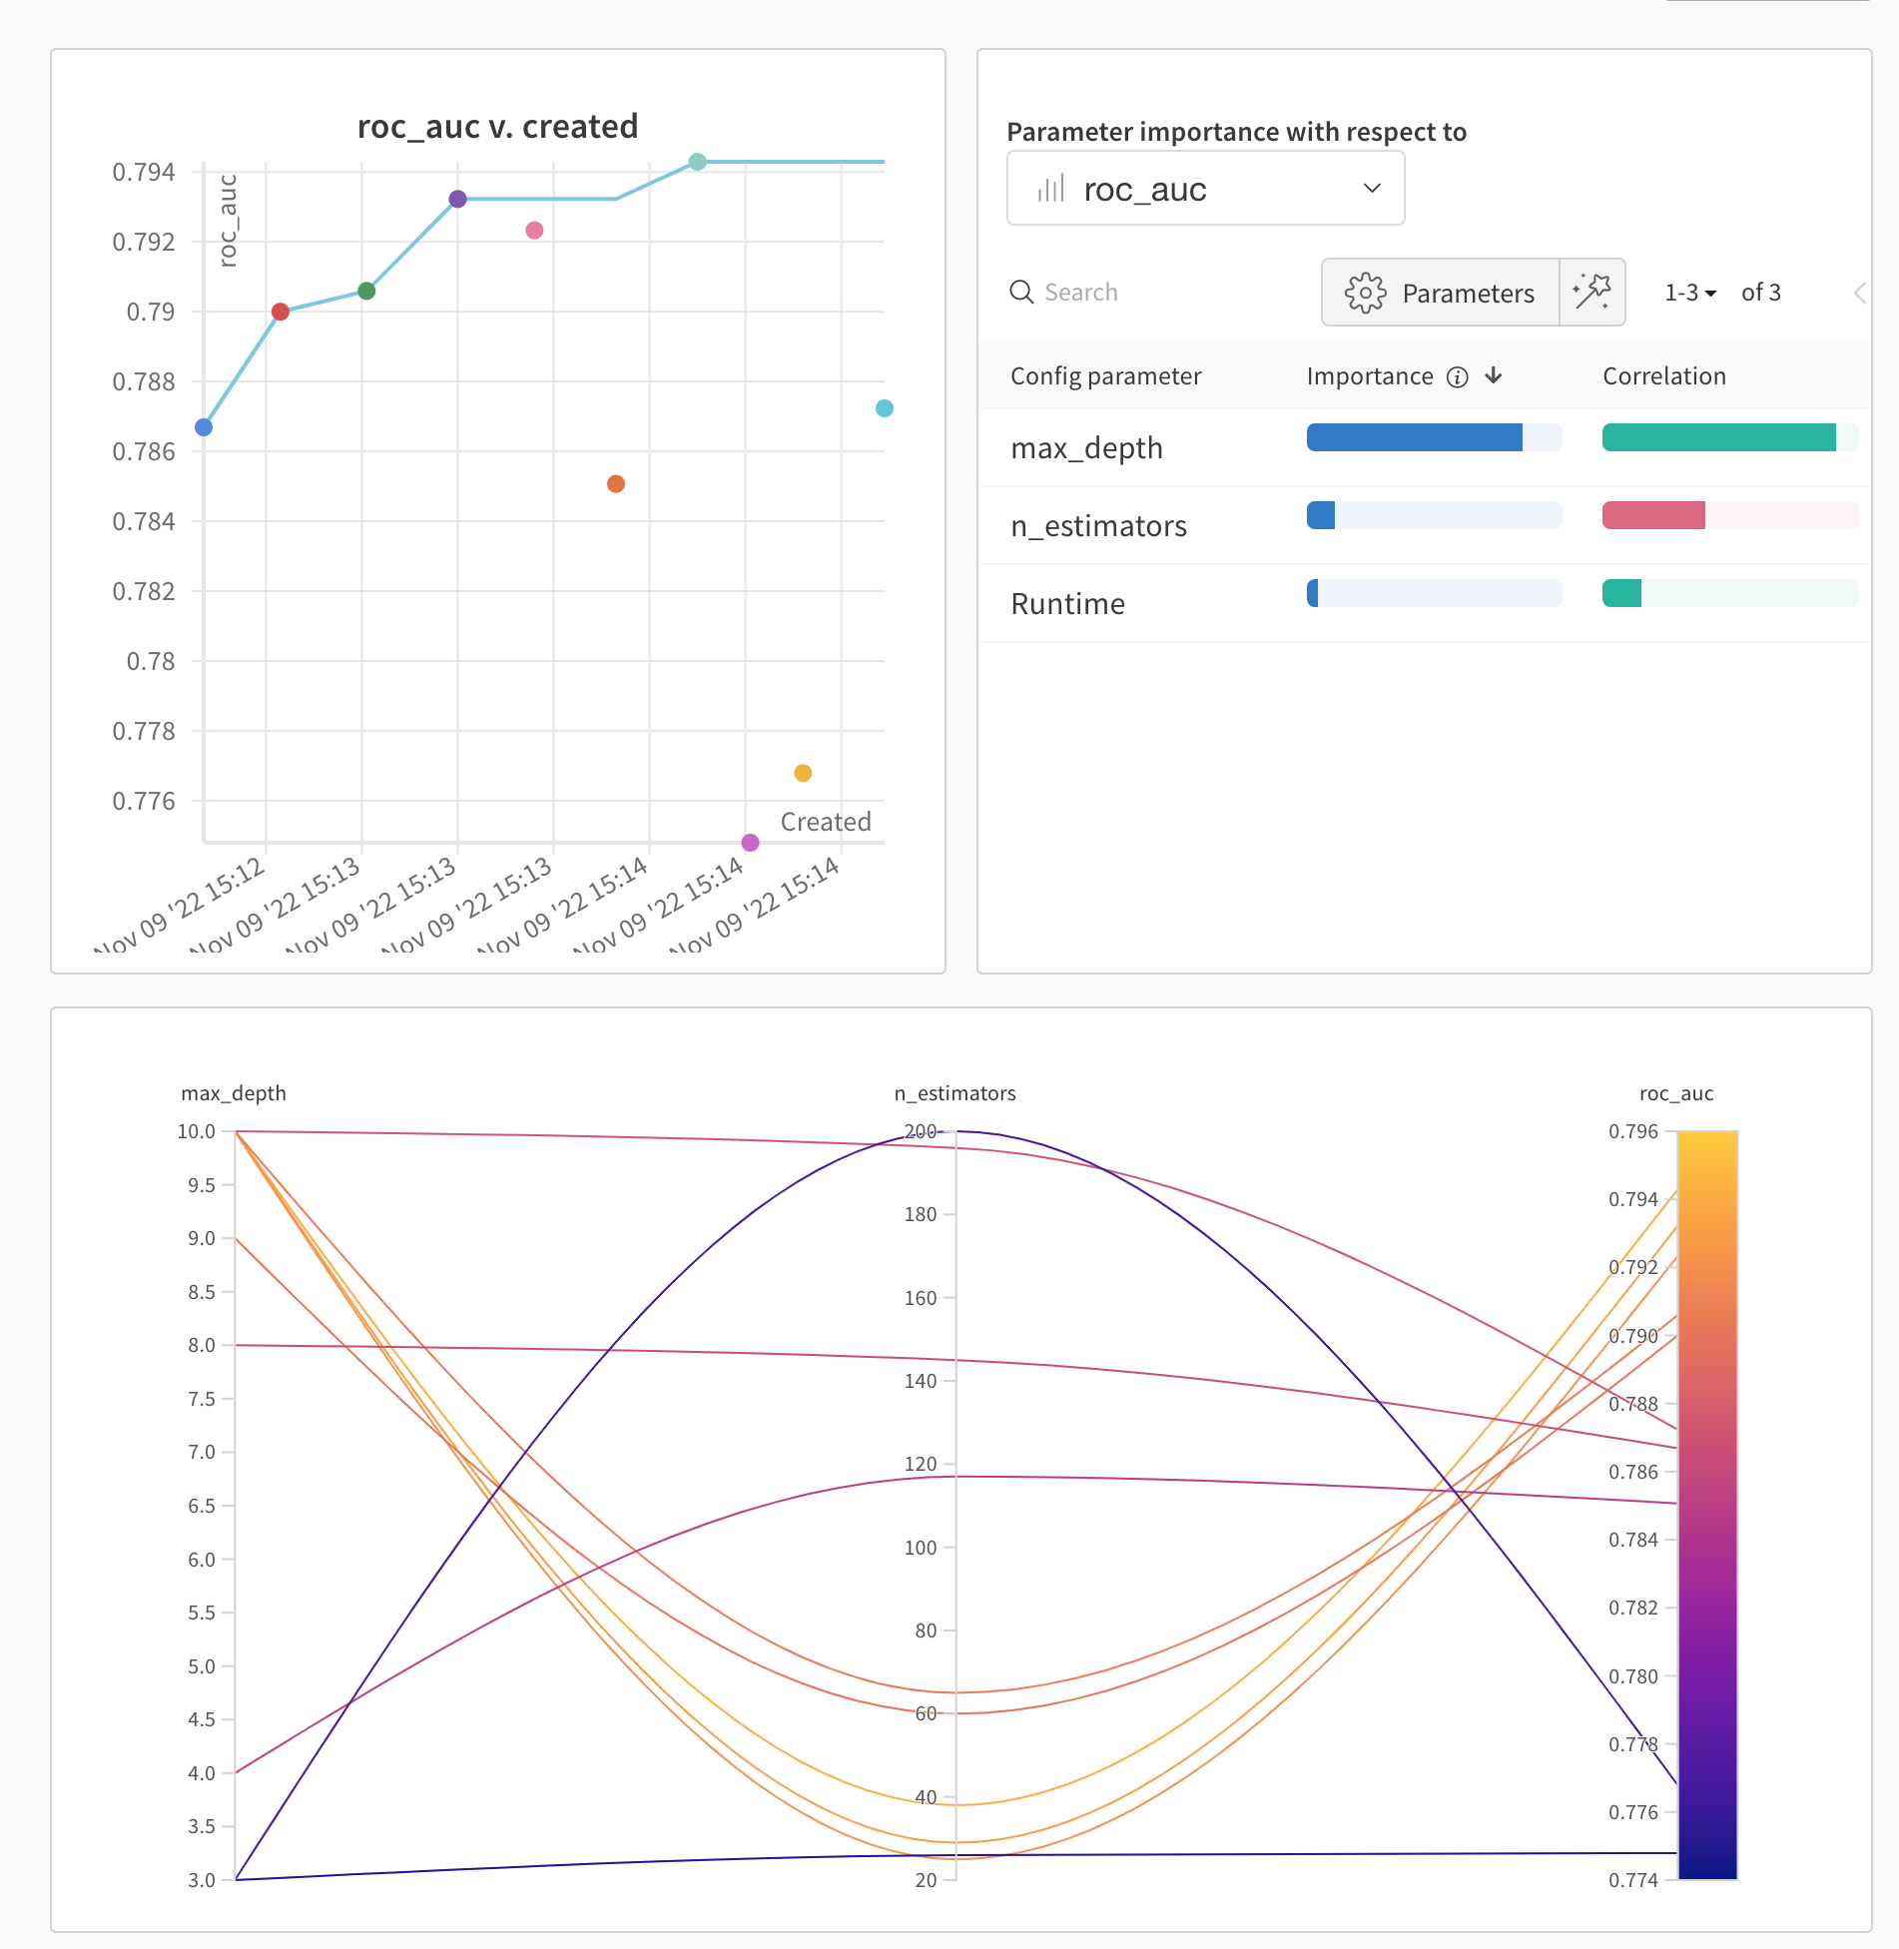
Sweeps hiperperameters wisely
… and identify the most important ones

